Slide 1
Laboratory Testing and Calibration of Vertically Oriented TDR Soil Moisture Sensors
By: Phillip McFarland

Slide 2
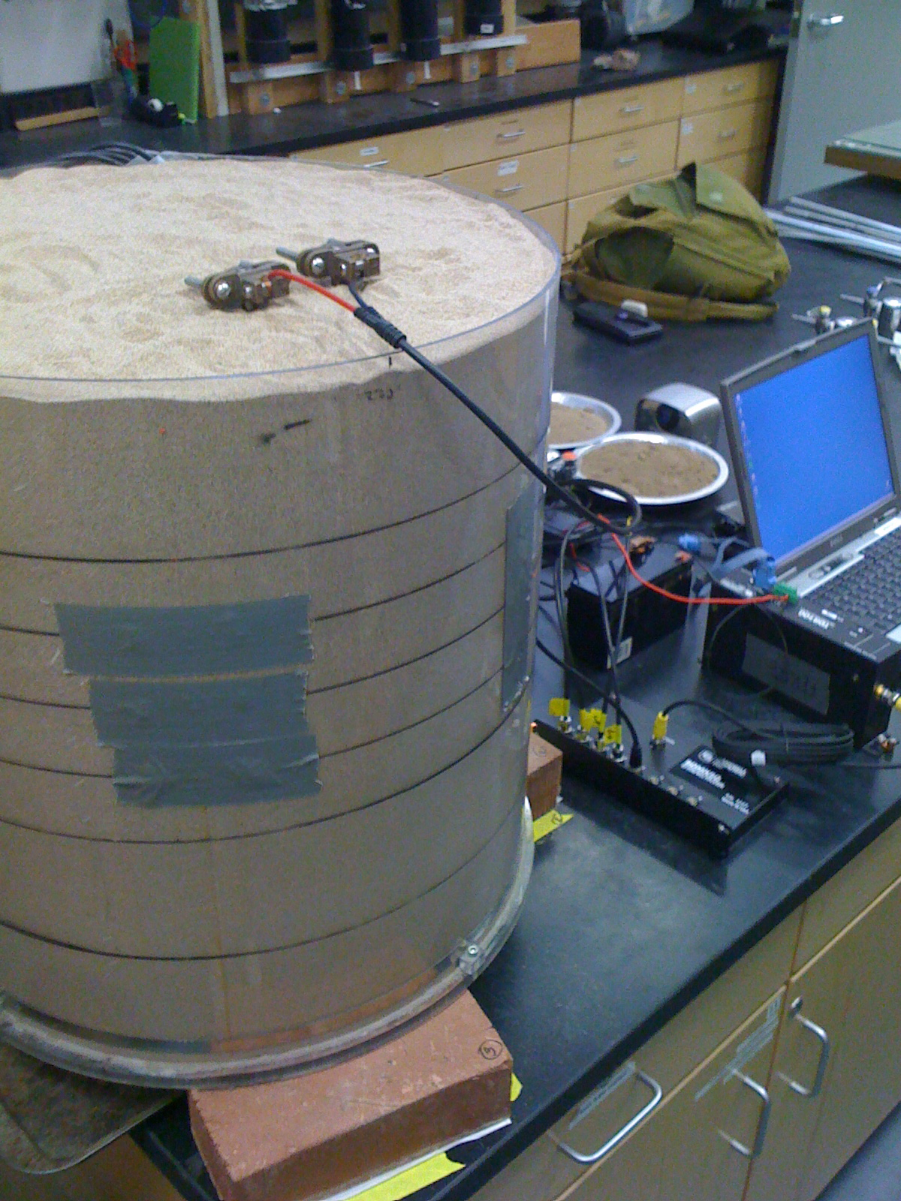
Project Recap:
Soil Moisture – agricultural, hydro-geological modeling and corrections to groundwater gravity measurements.
TDR – time domain reflectometry
VWC – volumetric water content

Slide 3
Principles of TDR
Maxwell:
Explanation of “Relative Permittivity”:
Applications of Relative Permittivity:
Ledieu Equation for VWC:

Slide 4
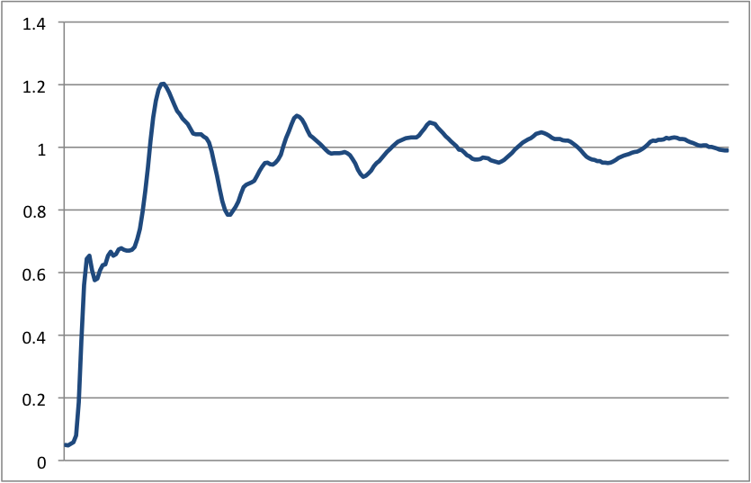
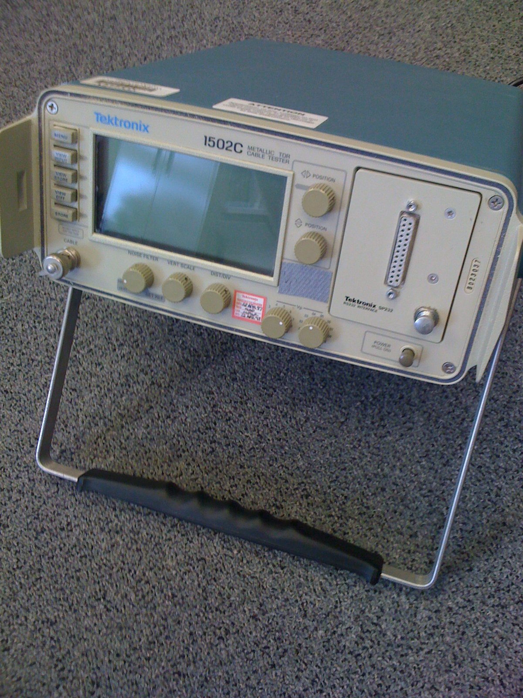
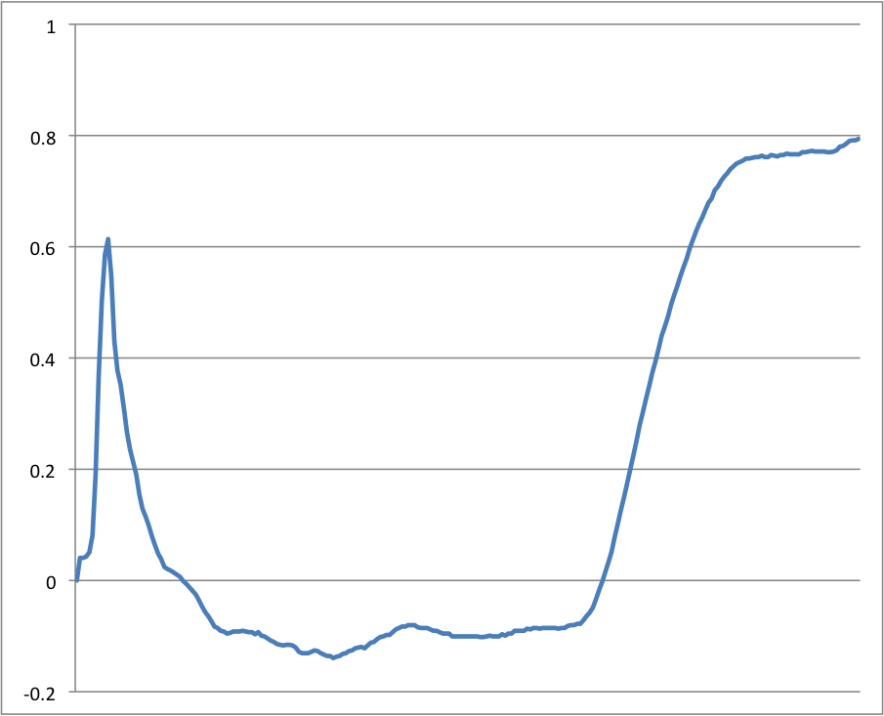
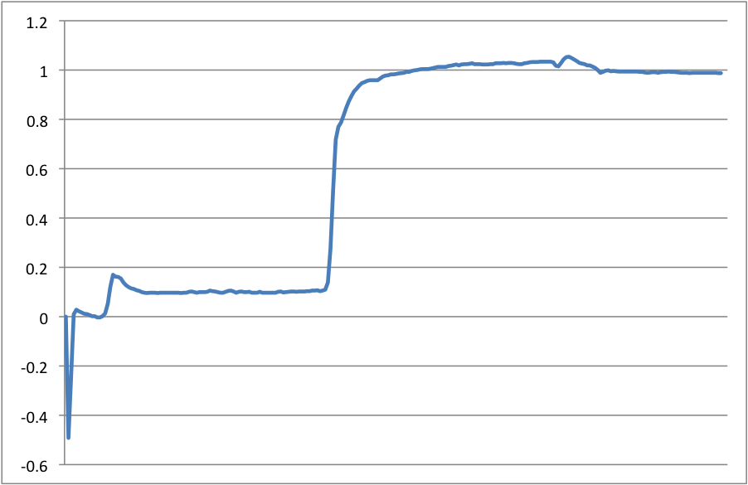
TDR Waveforms

Slide 5
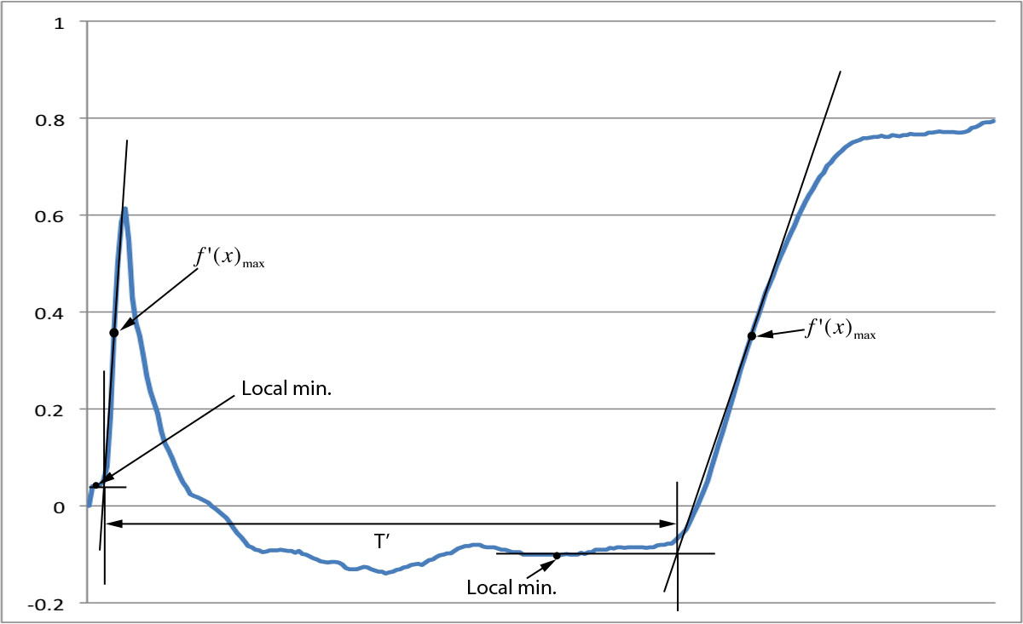
Waveform Interpretation

Slide 6
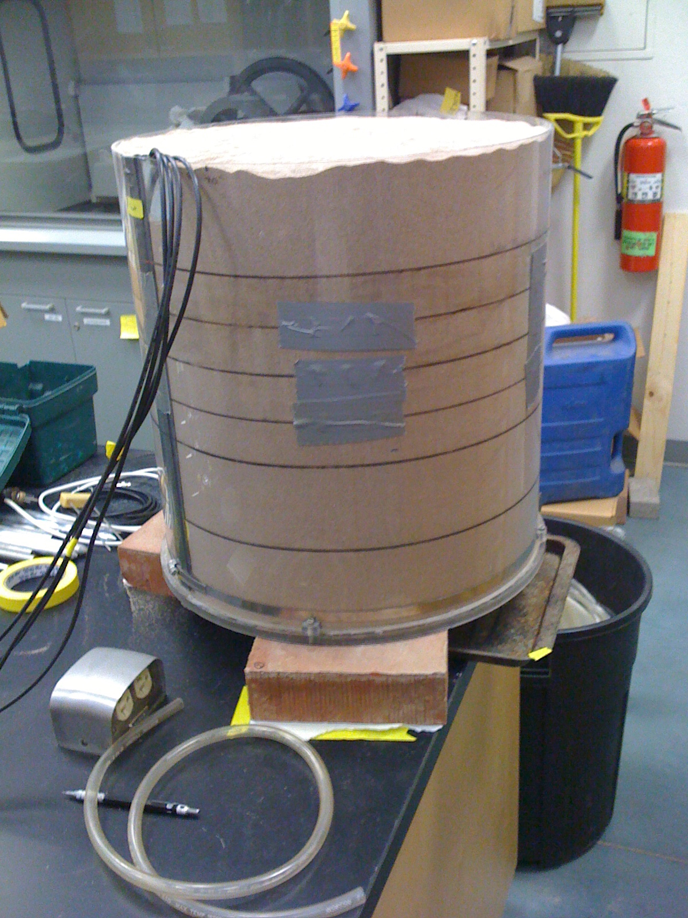
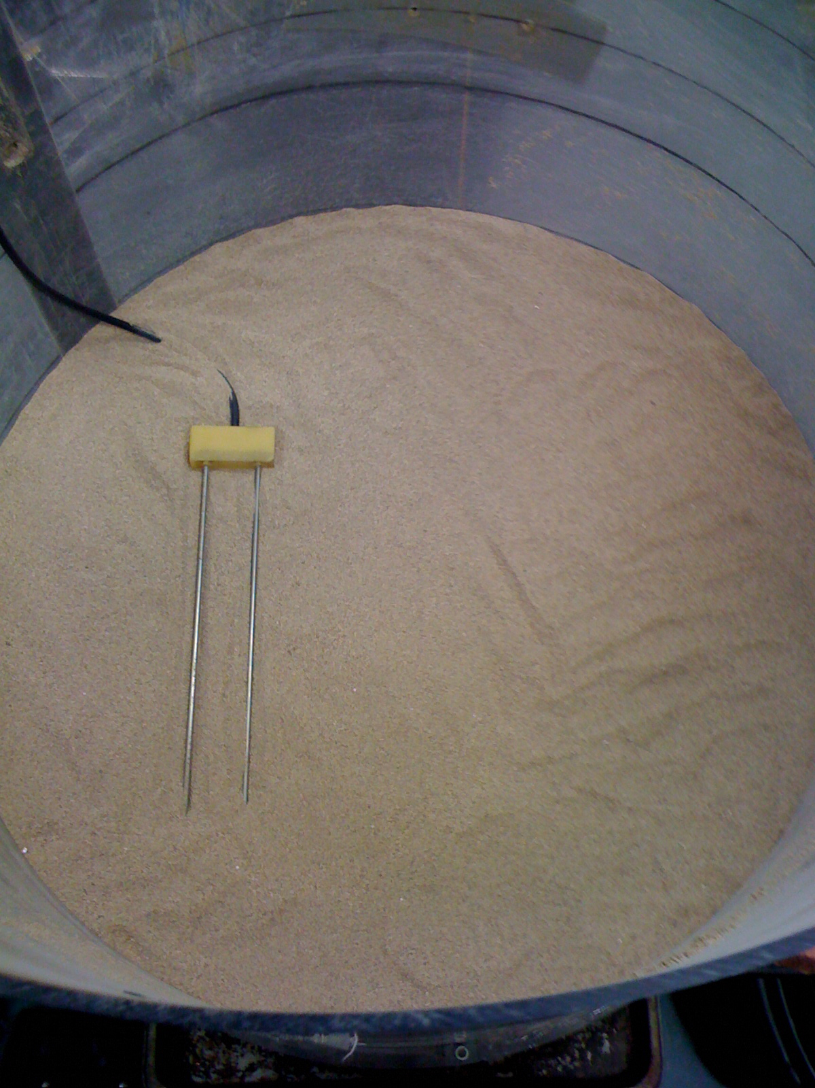
Horizontally Oriented Soil Moisture Sensor Probes
Proven technology
Very accurate VWC measurement
Little or no calibration required
Destructive to soil
In situ TDR device required
Costly
Limited sample volume per probe

Slide 7
Development of a Vertically Oriented TDR Probe System
Challenges:
Calibration of probe connectors
Larger sample volume
Average VWC over several layers v. local measurement at each layer
Unknown soil constituents may deflect probe installation (i.e. buried stones)
Best material for waveguides
Possible Advantages:
Easy installation
Cost effective
Fewer TDR devices required to survey a large land area. Especially when less frequent measurements are needed.

Slide 8
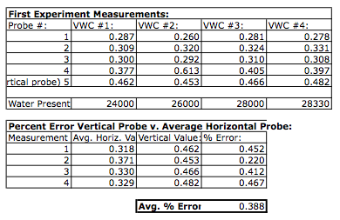
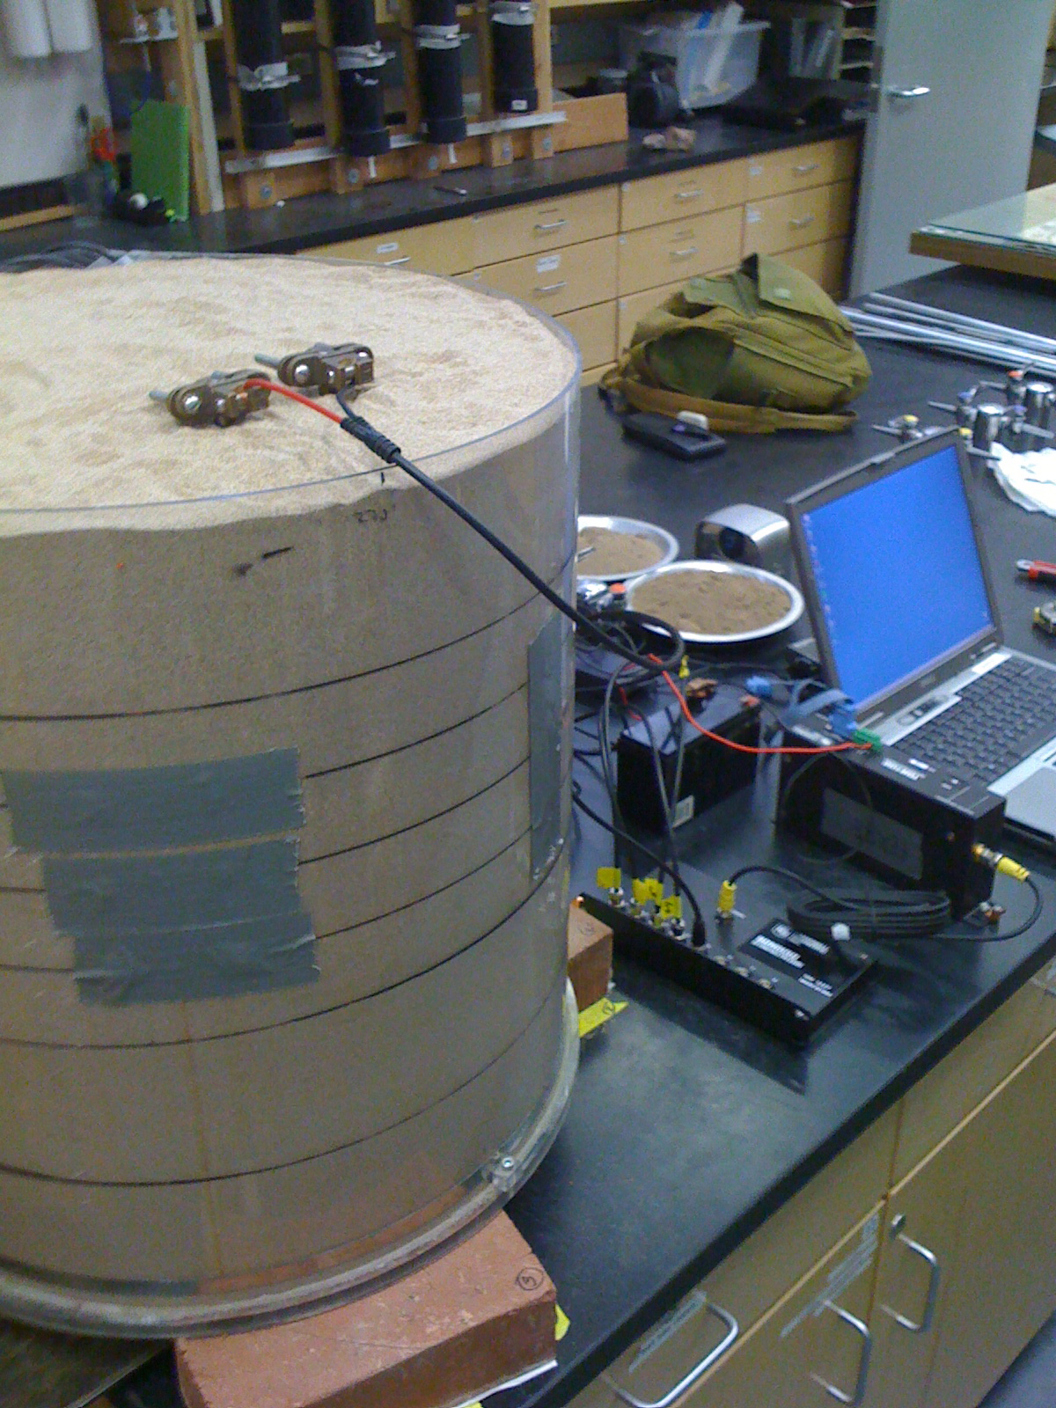
First Attempt!!
Results:
38% error!!
Interesting variations in pulse reflection from connectors
Probe calibration needed
Probe connector offset constant needed

Slide 9
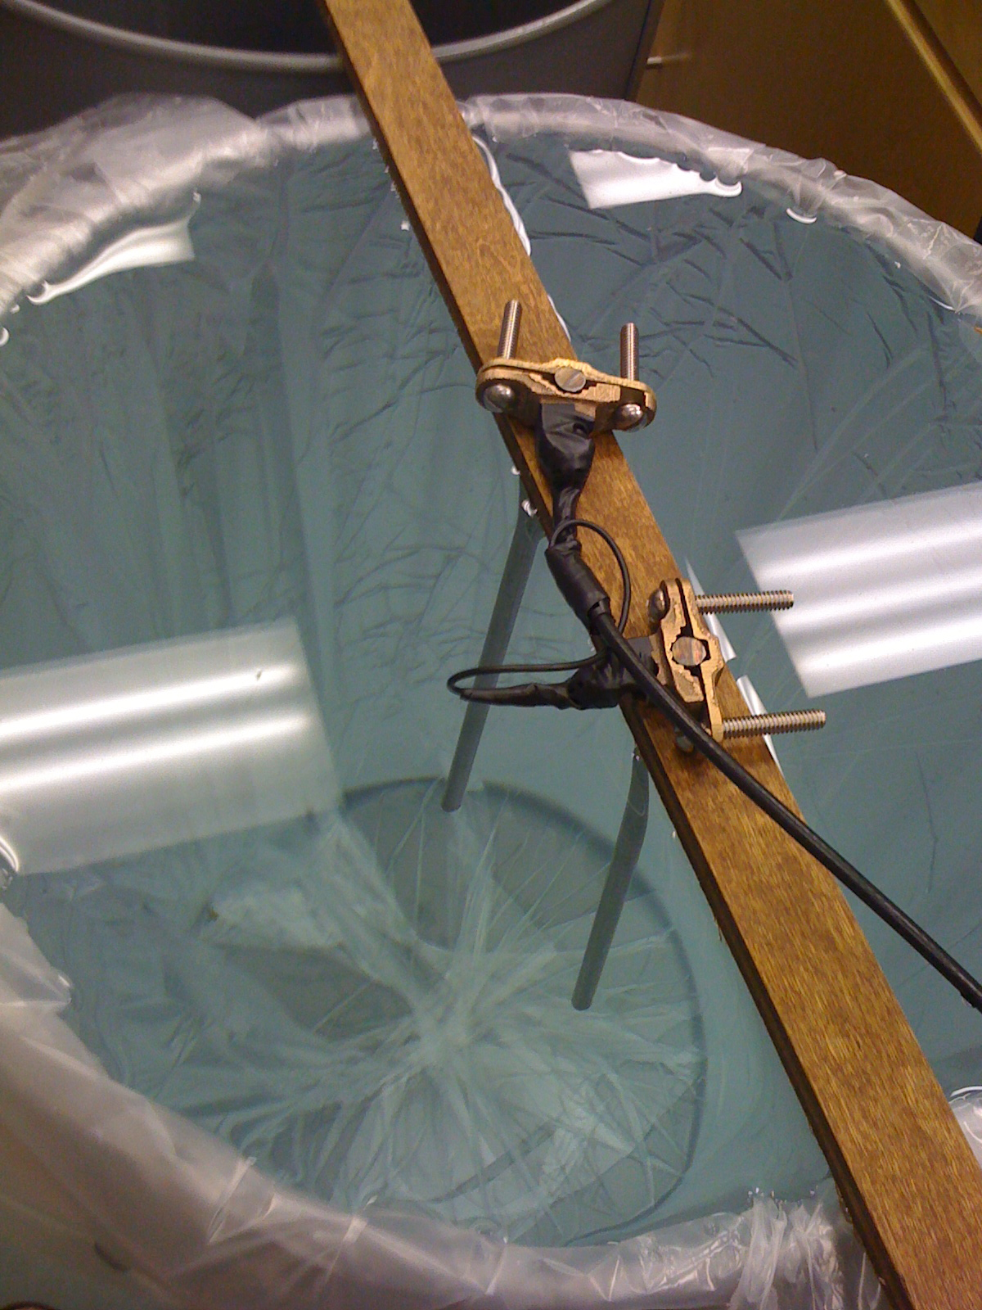
Theory of Connector Calibration

Slide 10
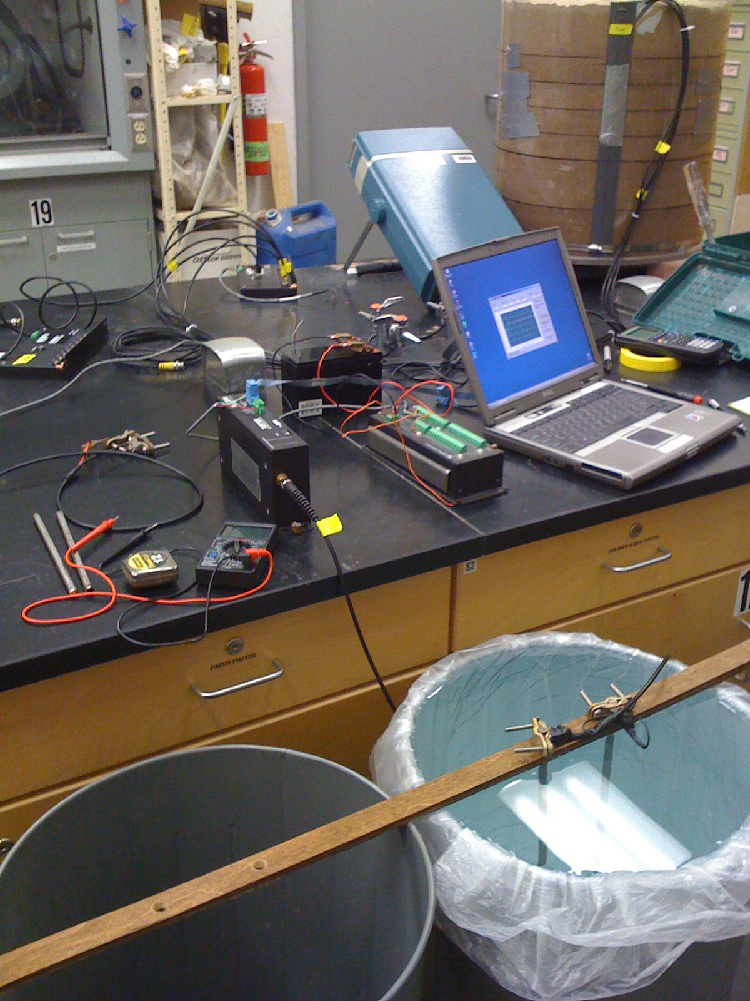
Calibration Method
20 probe pairs used
4 pairs @ lengths: 28, 24, 20, 16 and 8 in.
TDR measurements made in air and DI water
2 measurements made with each pair of waveguides in each medium with each connector
160 TDR measurements total made
Relative permittivity of water and air known
Measurements compared with theoretical values
Probe constant isolated empirically

Slide 11
Results of Calibration
Electrical path length constant of waveguide connectors was used to correct previous data collected
Average % error decreased by nearly 32%

Slide 12
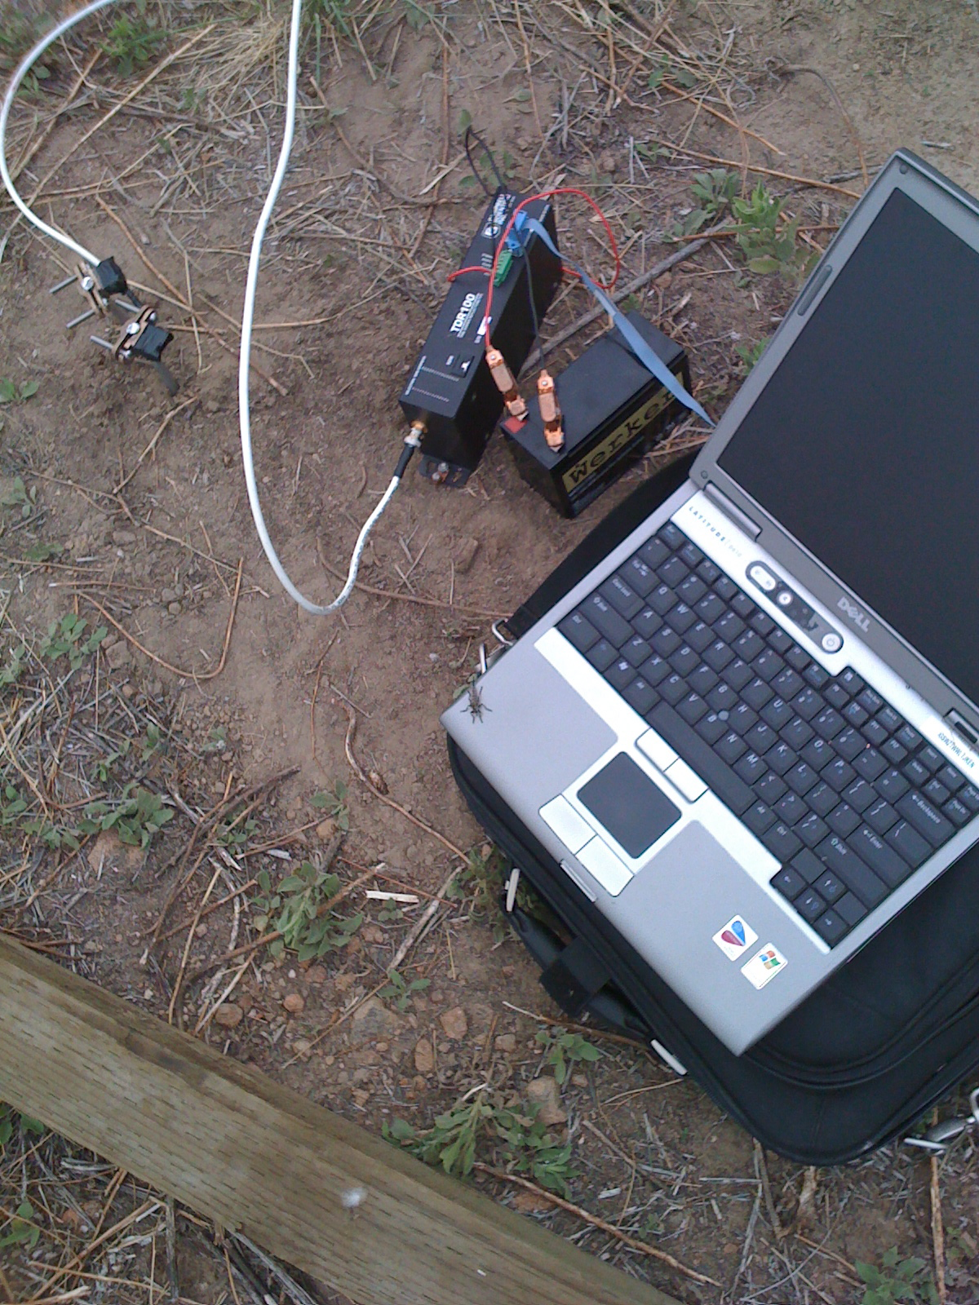
What’s Next
Develop a field ready model
Further test existing and new probes and connectors in a wider variety of conditions
Implement a comprehensive soil moisture system around gravity measurement sites
Use reliable soil moisture information to correct gravity ground water measurements

